Slide 1
ML Final Project
Authors: Leo Li, Oliver Li

Slide 2
Introduction
Stroke prediction dataset
Binary classification problem
Models
Logistic
Support Vector Machine (SVM)
Neural Networks (NN)

Slide 3
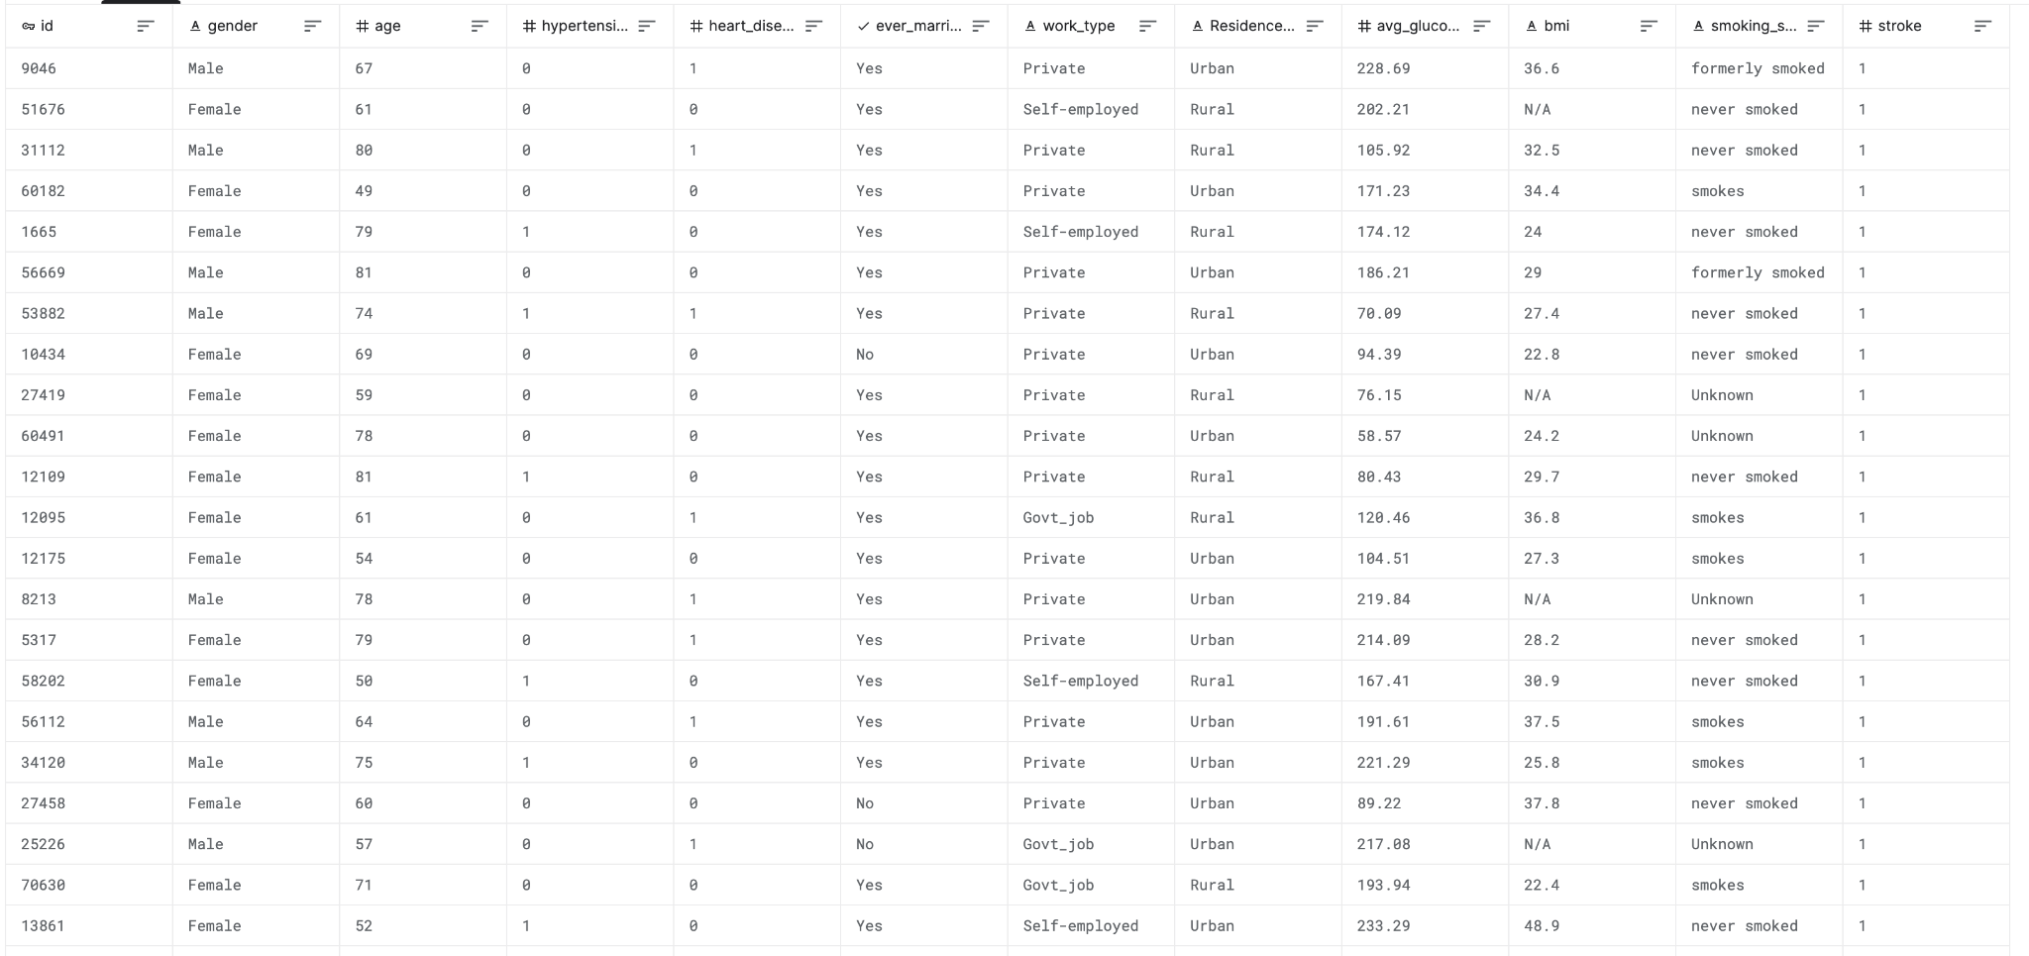
Data

Slide 4
Data Preparation
Removed outliers
Repaired incomplete features
Categorical Encoding
Label Encoding
One-hot Encoding
Normalization Scaling
Data splits: 60% train, 20% validation, 20% test

Slide 5
Logistic Regression
Polynomial Feature Transformation
K-fold cross validation for regularization C selection

Slide 6
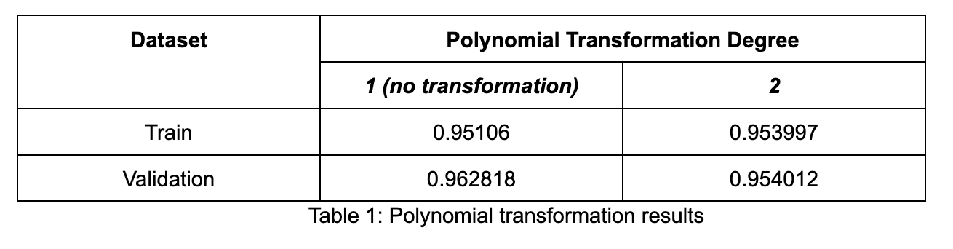
Polynomial Feature Transformation
Degree 1: 18 features
Degree 2: 171 features
Degree 3: 1140 features

Slide 7
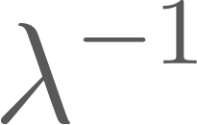
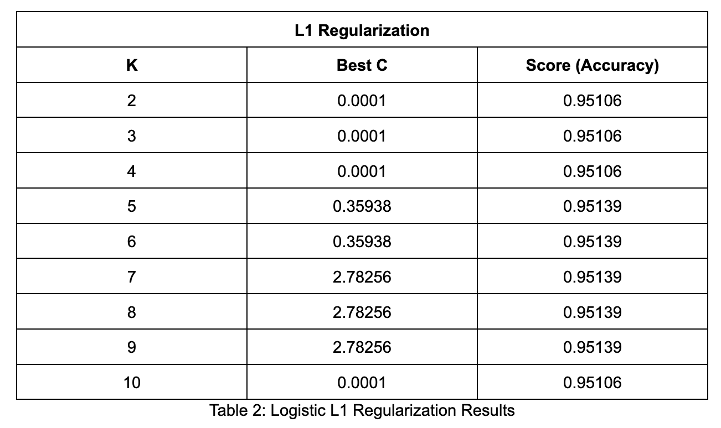
K-Fold CV with Regularization
C = , 10 values tested from 0.0001 to 10000

Slide 8
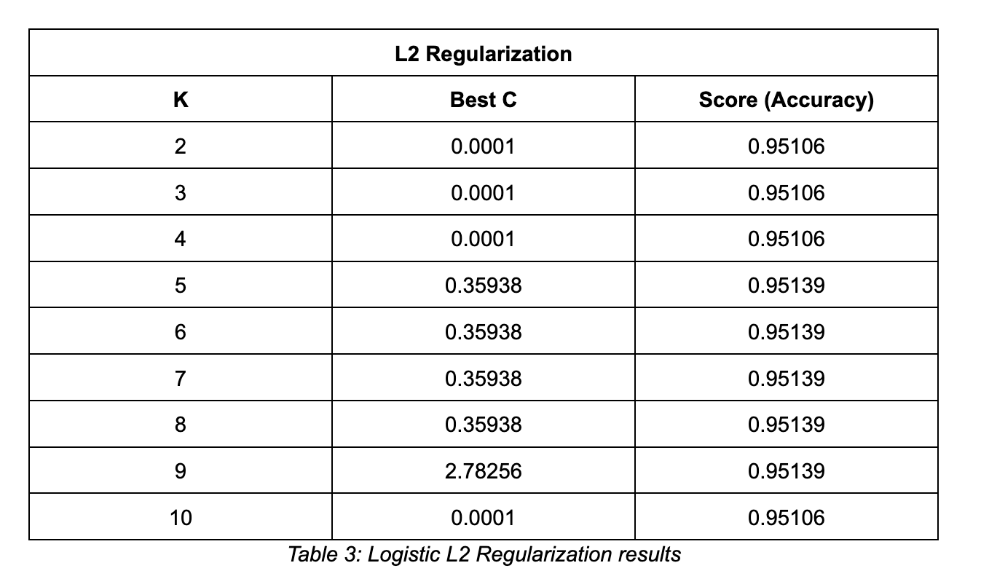
K-Fold CV with Regularization
C = , 10 values tested from 0.0001 to 10000

Slide 9
Logistic Regression - Conclusion
Best model: No polynomial feature transformation, no regularization
Test set accuracy: 0.9413
Insights:
Best C values suggest data is very linearly separable
Rest of loss probably caused by irreducible noise

Slide 10
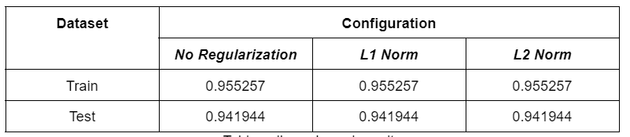
Support Vector Machine: Linear Kernel
Observed convergence of results

Slide 11
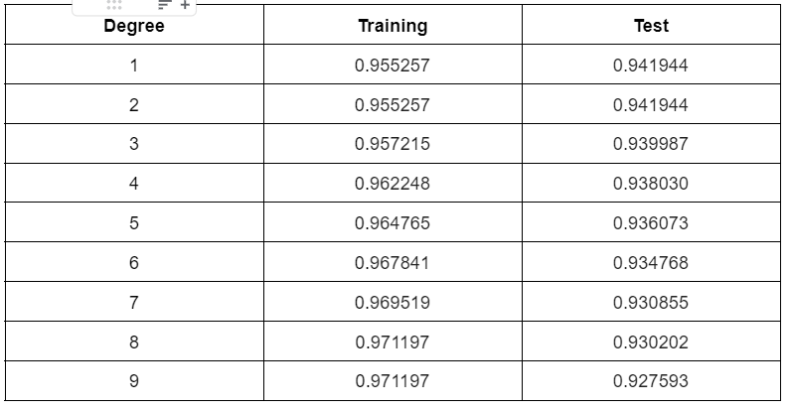
Support Vector Machine: Polynomial Kernel

Slide 12
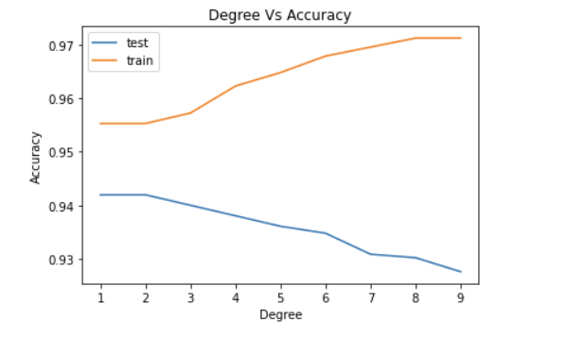
Support Vector Machine: Polynomial Kernel

Slide 13
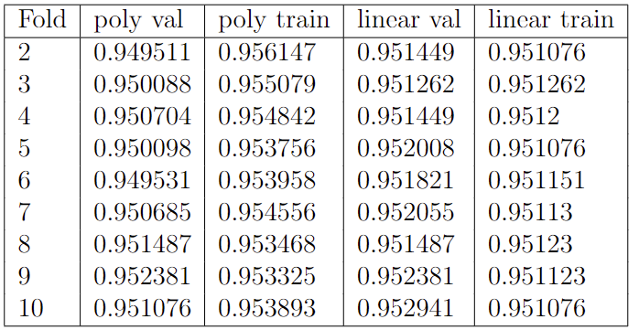
K-Fold Cross Validation
20% test set, 80% train and validation
Folds: 2, 3, 4 … 10

Slide 14
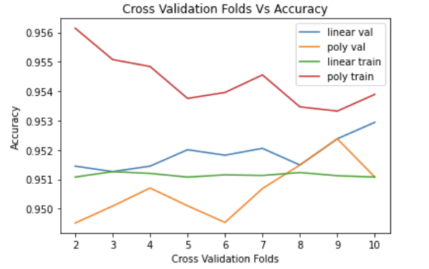
K-Fold Cross Validation
Best linear validation accuracy: 0.952941
Best polynomial validation accuracy: 0.952381

Slide 15

Test Scores
Slight improvement with cross validation
Convergence around 0.94

Slide 16
Neural Network
No regularization on neural networks of 3, 4, and 5 layers
3 Layer: 17 - 10 - 1
4 Layer: 17 - 10 - 5 - 1
5 Layer: 17 - 12 - 7 - 4 - 1
L1 and L2 regularization on all neural networks above
Experiment Settings:
Bias: Included
Metric: Accuracy
Batch size: 10, Epochs = 70

Slide 17
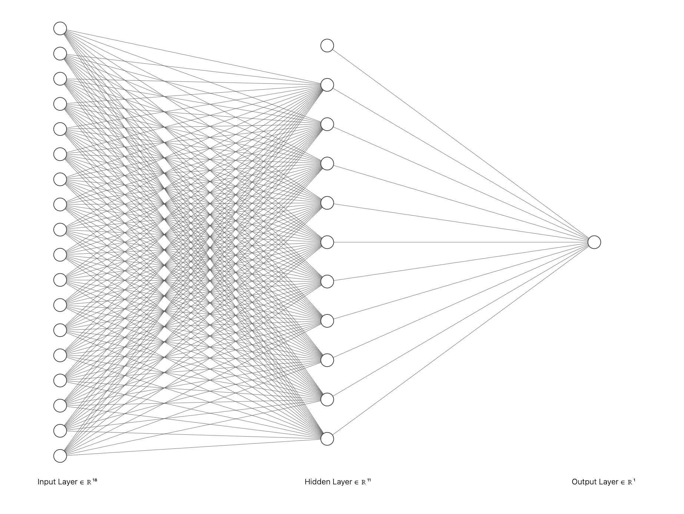
Three Layer Neural Network

Slide 18
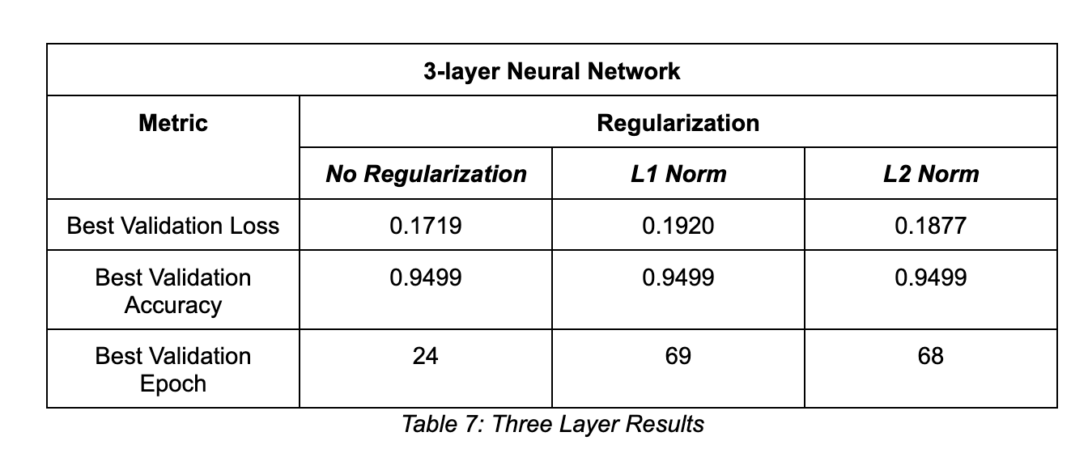
Three Layer Neural Network

Slide 19
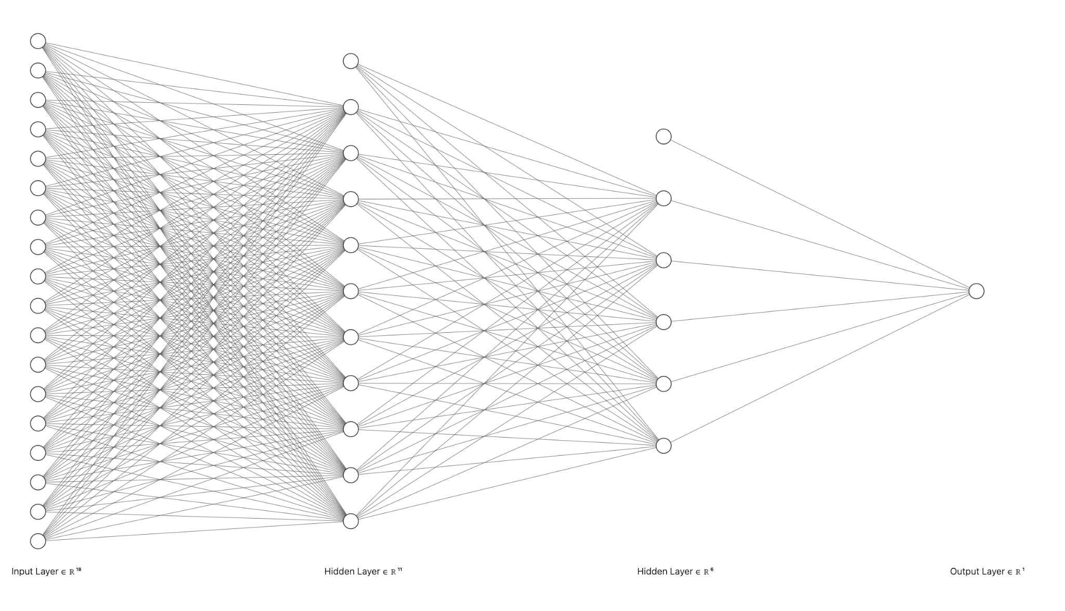
Four Layer Neural Network

Slide 20
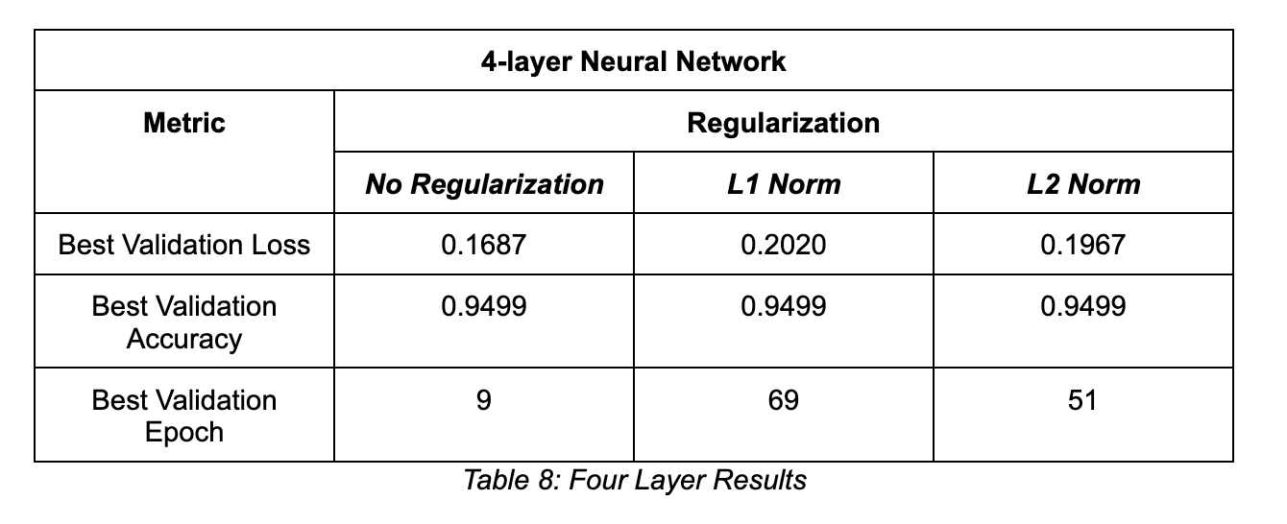
Four Layer Neural Network

Slide 21
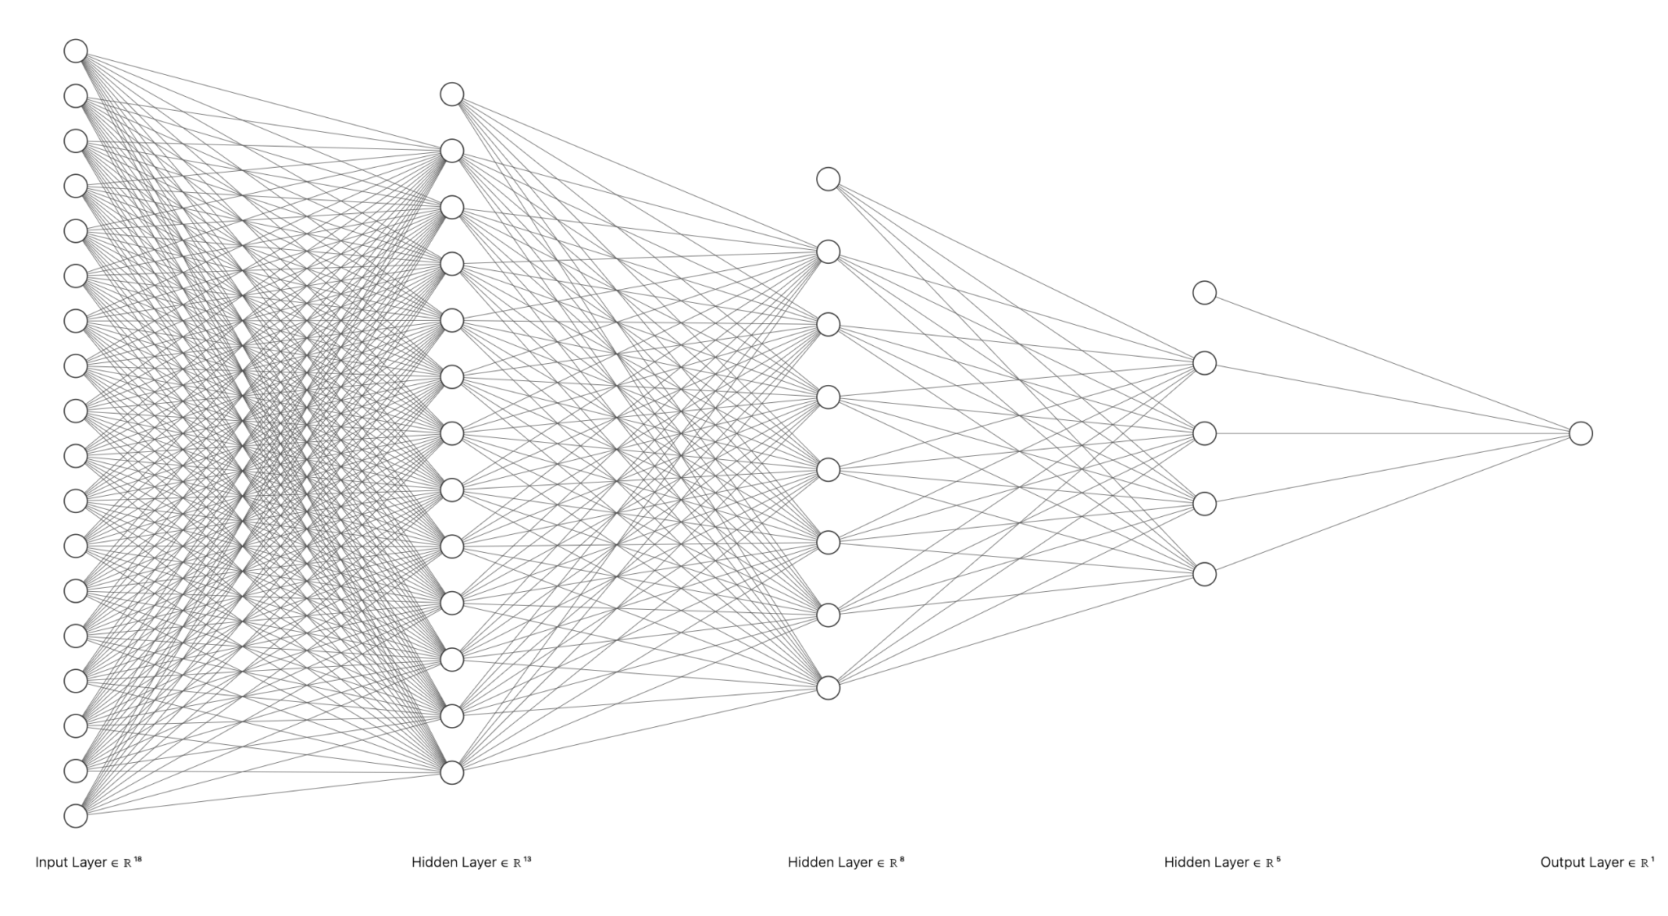
Five Layer Neural Network

Slide 22
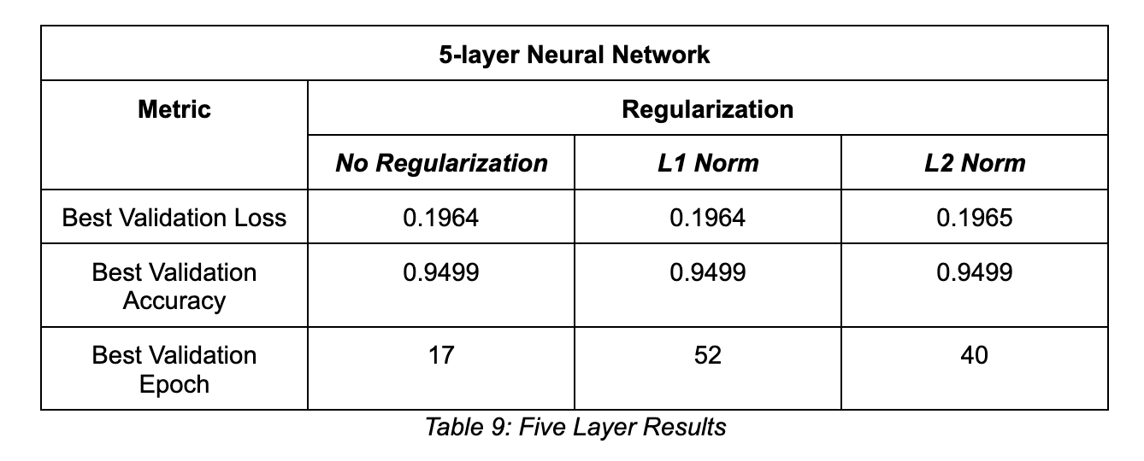
Five Layer Neural Network

Slide 23
Neural Network - Conclusions
Best Model: 4 layers, no regularization
Test loss and accuracy: 0.1808, 0.9413
Insights:
Better with no regularization, but needs validation & early stopping
Underfitting with regularization

Slide 24

Final Conclusion
Polynomial kernel SVM with 9 fold cross validation wins!
Dataset is extremely linearly separable,
Potential Bottleneck:
Outliers in the dataset
Unaccounted/missing features in the dataset
Noise / variance in the problem itself

Slide 25
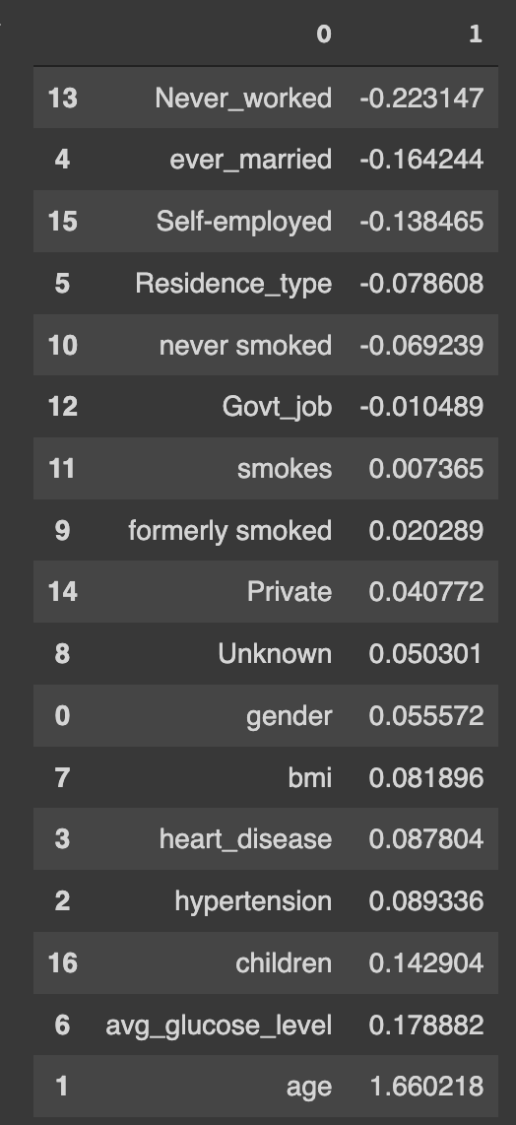
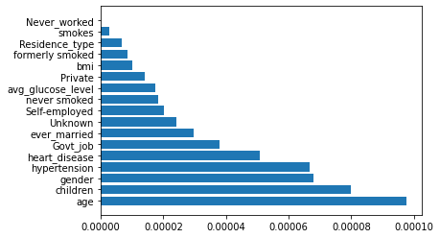
Logistic Regression & SVM Biggest Contributors

